Slide 1
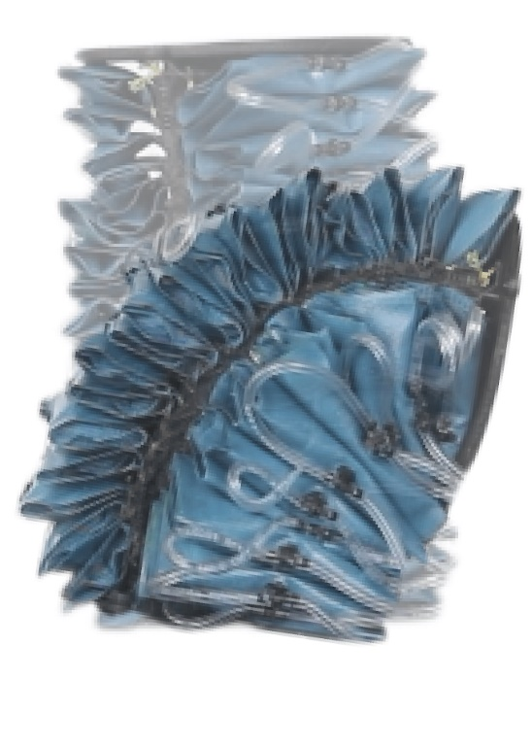
Sliding mode control with nonlinear disturbance observer and state switch (SMCWNDOS)
Develop augmented-rigid arm model for fabric-pillow-based actuator without backbone
Design a baseline SMC method for SISO system path tracking
Design a disturbance observer to reduce the input chattering and estimate lumped disturbance
Experimental results for contact and no contact cases

Slide 2
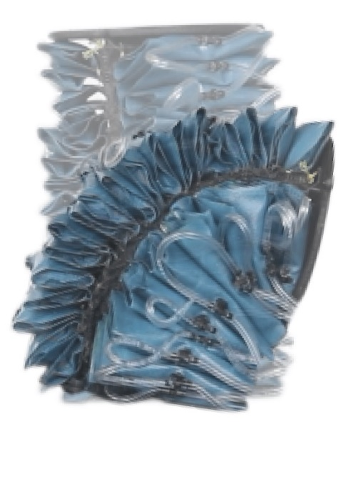
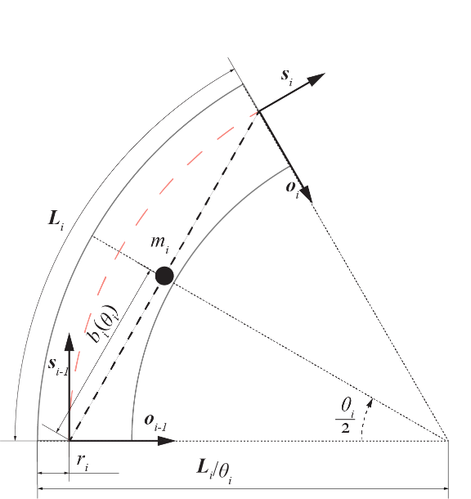
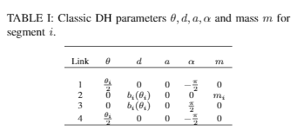
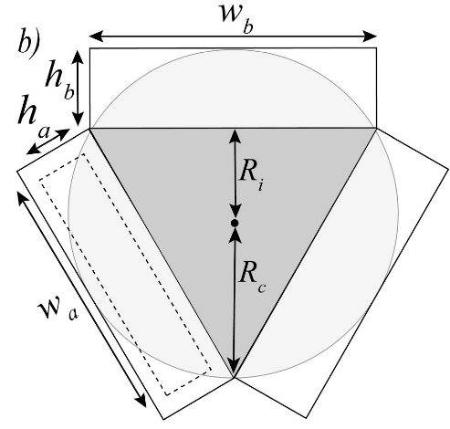
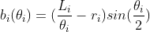
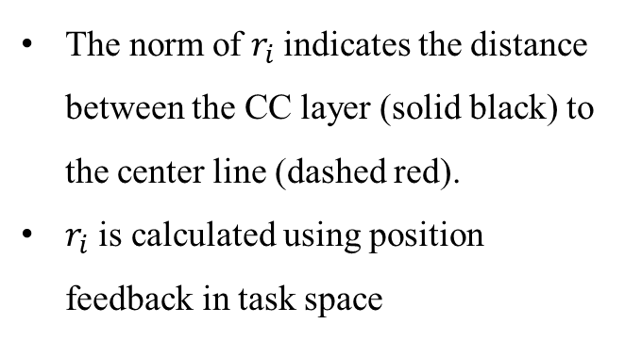
Augmented-rigid Arm Model
Fabric-pillow-based arm:
Hollowed in the center but with inextensible layer
Serial connected pillow actuators
The norm of $r_{i}$indicates the distance between the CC layer (solid black) to the center line (dashed red).
$r_{i}$ is calculated using position feedback in task space

Slide 3
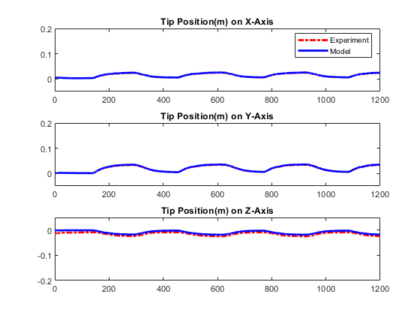
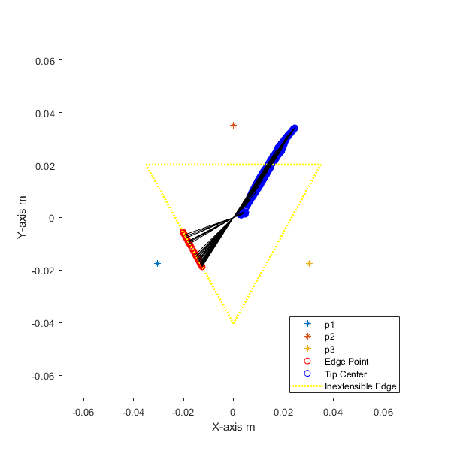
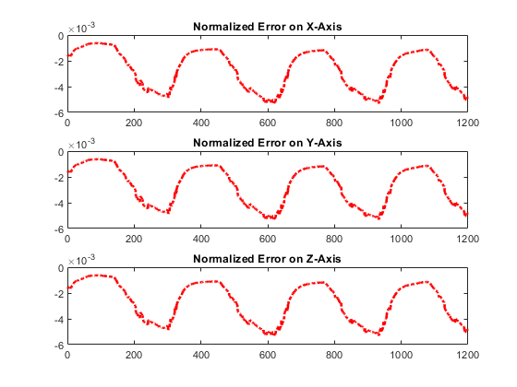
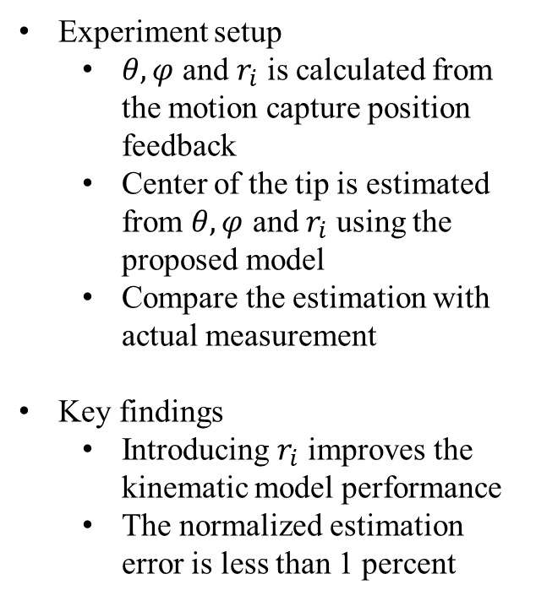
Forward Kinematic Results
Experiment setup
$θ,φ$ and $r_{i}$ is calculated from the motion capture position feedback
Center of the tip is estimated from $θ,φ$ and $r_{i}$ using the proposed model
Compare the estimation with actual measurement
Key findings
Introducing $r_{i}$ improves the kinematic model performance
The normalized estimation error is less than 1 percent
Experimental results. (Left) update rule
(Right) position errors in task space

Slide 4
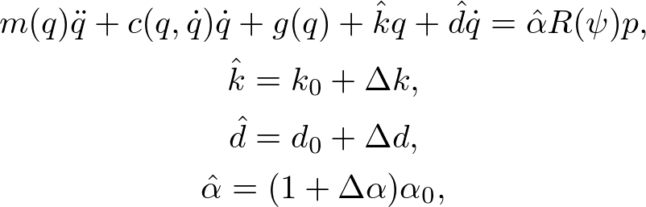
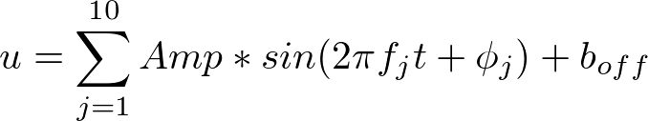
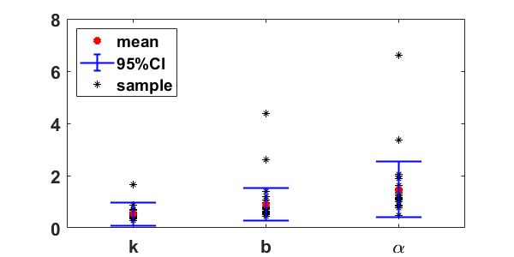
Dynamic Model with Parameter Uncertainties
Full system dynamics
System with bounded uncertainties
System Identification
Excitation Signal
Total trials: 30
Trial duration: 30 sec
System ID results

Slide 5
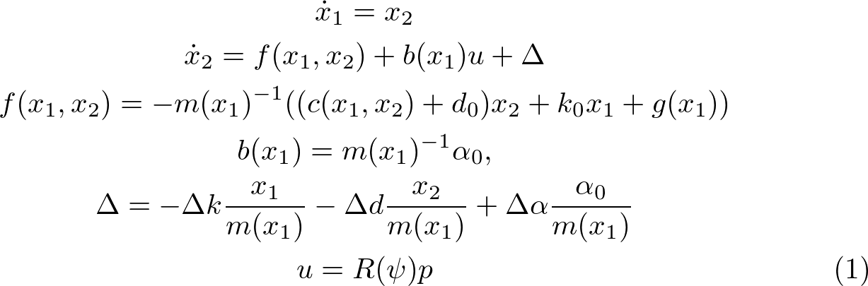
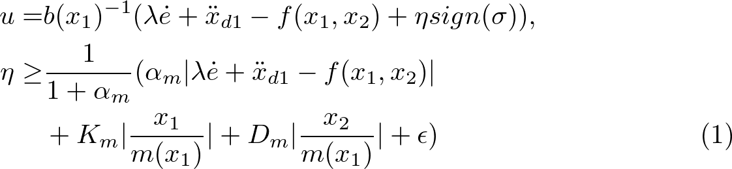

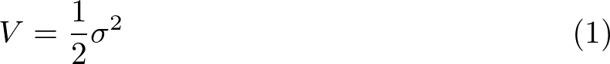
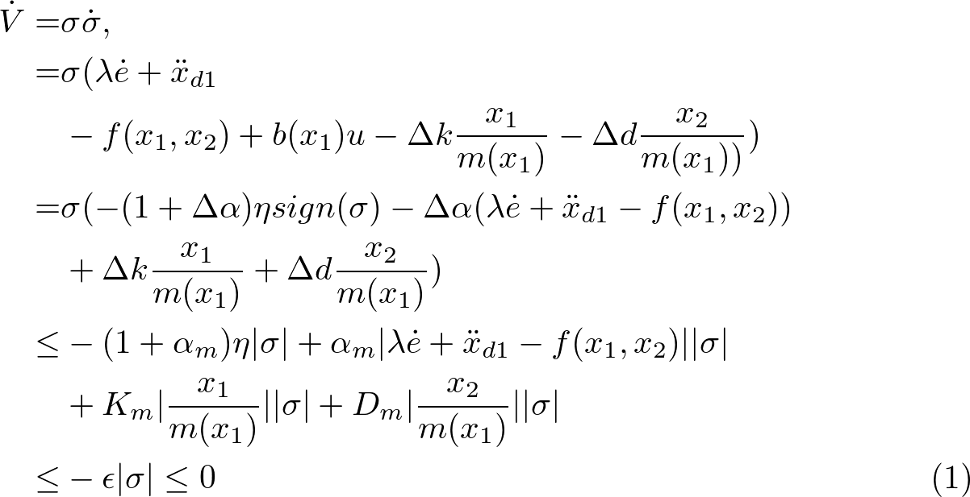
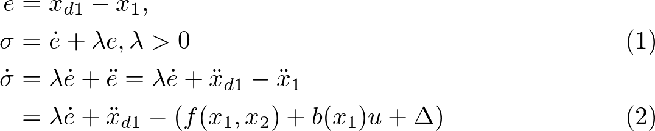
Baseline SMC Design
State space representation
Control input
Stability proof
Sliding surface
Reaching law

Slide 6
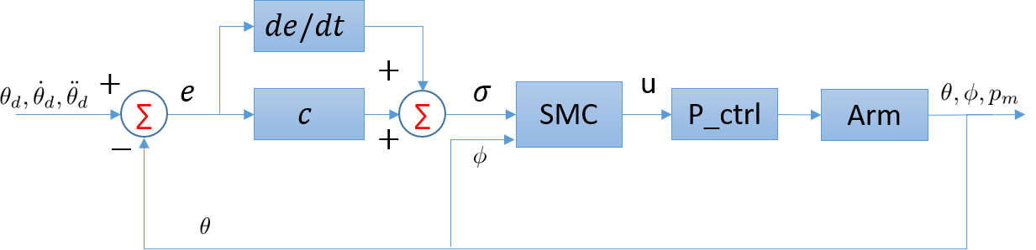
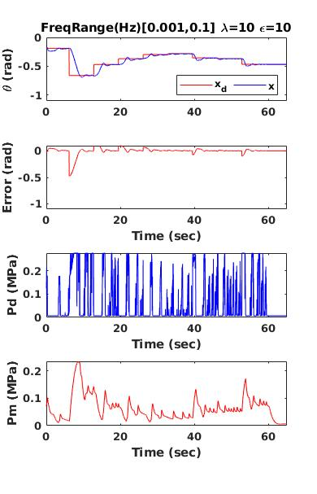
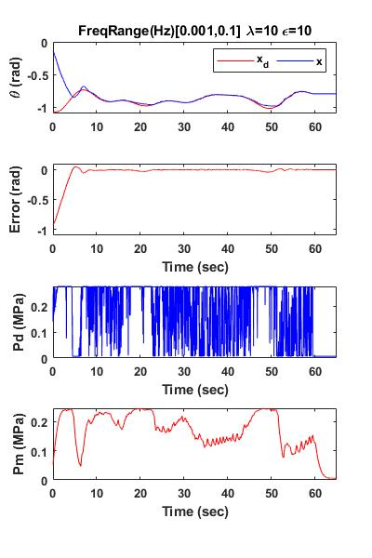
Experimental Results
Experiment setup
Multi-steps signal: Randomly selected in [-10,-40] degrees
Sum-of-sines signal: frequency range [0.001,0.1] Hz
Key findings
Baseline SMC method can track refence signal in both cases
Input chattering needs to be reduced
(Left) Multi-Steps (Right) Sum of sine waves

Slide 7
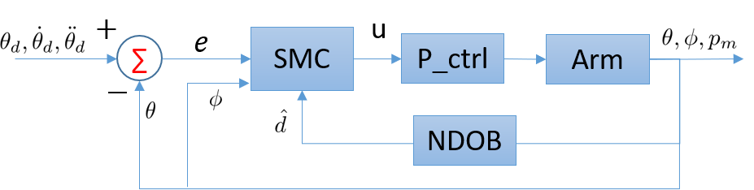
Nonlinear Disturbance Observer
Assumptions
Lumped disturbance is bounded
The time derivative of the lumped disturbance is also bounded
When contacting with environment, the external disturbance is dominant
Goals
Estimate contact force and detect contact event
Stay compliant during the contact and recover back to desired path automatically
Find proper candidate function to ensure the closed-loop system is stable

Slide 8
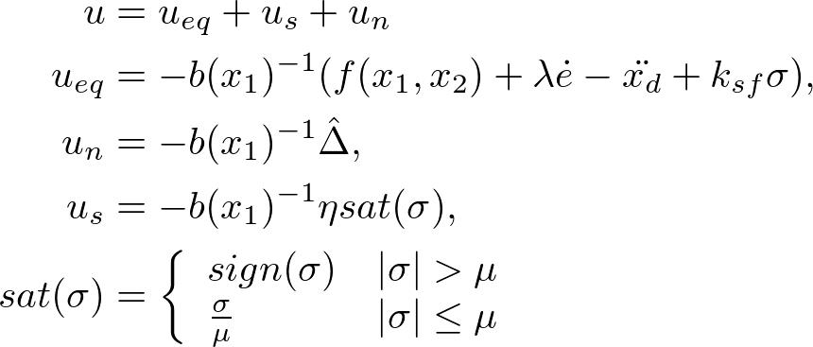
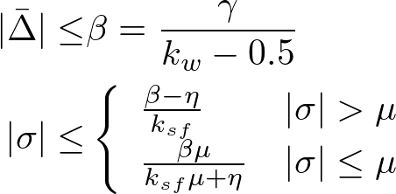
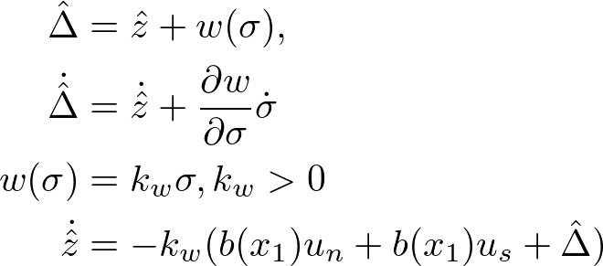
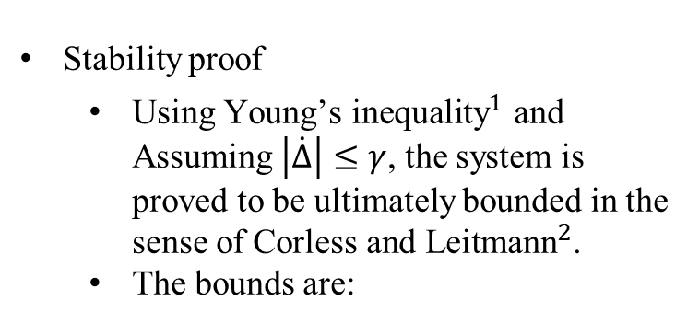
Sliding mode control with nonlinear disturbance observer (SMCNDO)
Redesign control input
Stability proof
Using ${\text{Young}\text{’}\text{s} \text{inequality}}^{1}$ and Assuming $\left|\dot{∆}\right|≤γ$, the system is proved to be ultimately bounded in the sense of ${\text{Corless} \text{and} \text{Leitmann}}^{2}$.
The bounds are:
Design of NDOB
Bartle, R.G. and Sherbert, D.R., 2000. Introduction to real analysis (Vol. 2). New York: Wiley.
Corless, M. and Leitmann, G., 1981. Continuous state feedback guaranteeing uniform ultimate boundedness for uncertain dynamic systems. IEEE Transactions on Automatic Control, 26(5), pp.1139-1144.

Slide 9
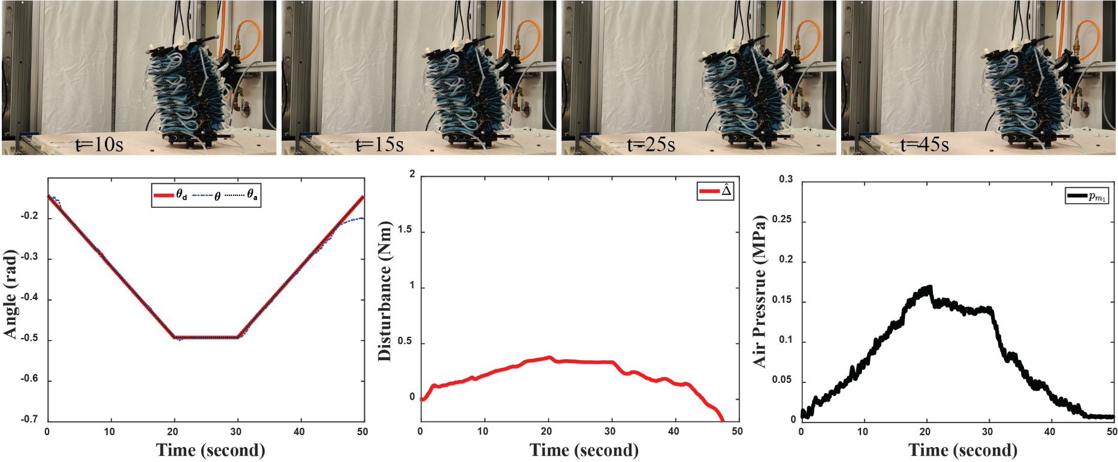
Experimental Results
Experiment setup
Ramp rate: 1 rad/s
No Object in the space
Total of 5 trials
Key findings
SMCNDO can track the desired path
No saturation in chamber pressure

Slide 10
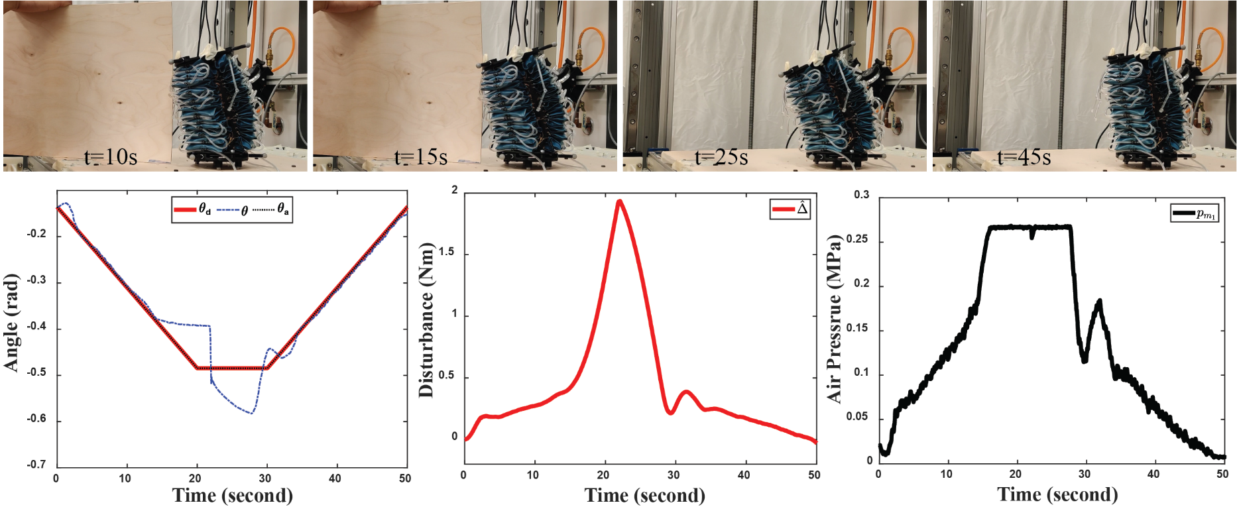
Experimental Results
Experiment setup
Ramp rate: 1 rad/s
Object stay till 22 secs
No further contact
Total of 5 trials
Key findings
SMCNDO can detect the contact
Controller can track the path
High estimated disturbance values
Severe oscillation after contact ends

Slide 11
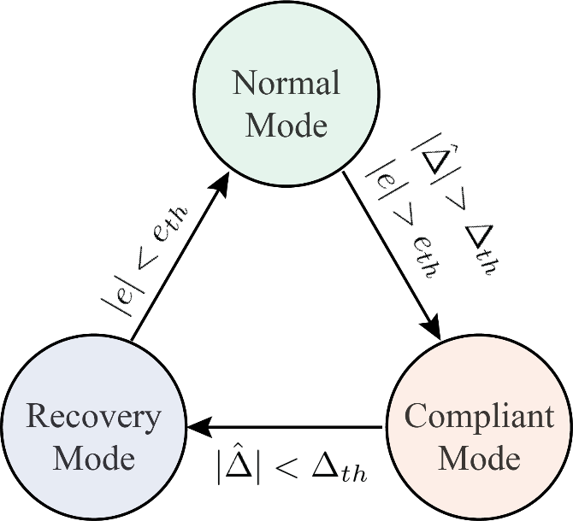
Soft contact with SMCWNDOS
Switch conditions
Normal to Compliant: The estimated lumped disturbance and the tracking error goes beyond the threshold
Compliant to Recovery: The estimated disturbance reduces below the threshold
Recovery to Normal: The tracking error reduces below the threshold
Desired path augmentation:
Normal: original path
Compliant: current position
Recovery: ramp path from the current position to the original path
Assumptions
the system always starts with no contact with the object
The stiffness of the object is higher than the system and the object stays stationary during the contact.
No further contact after the object is removed

Slide 12
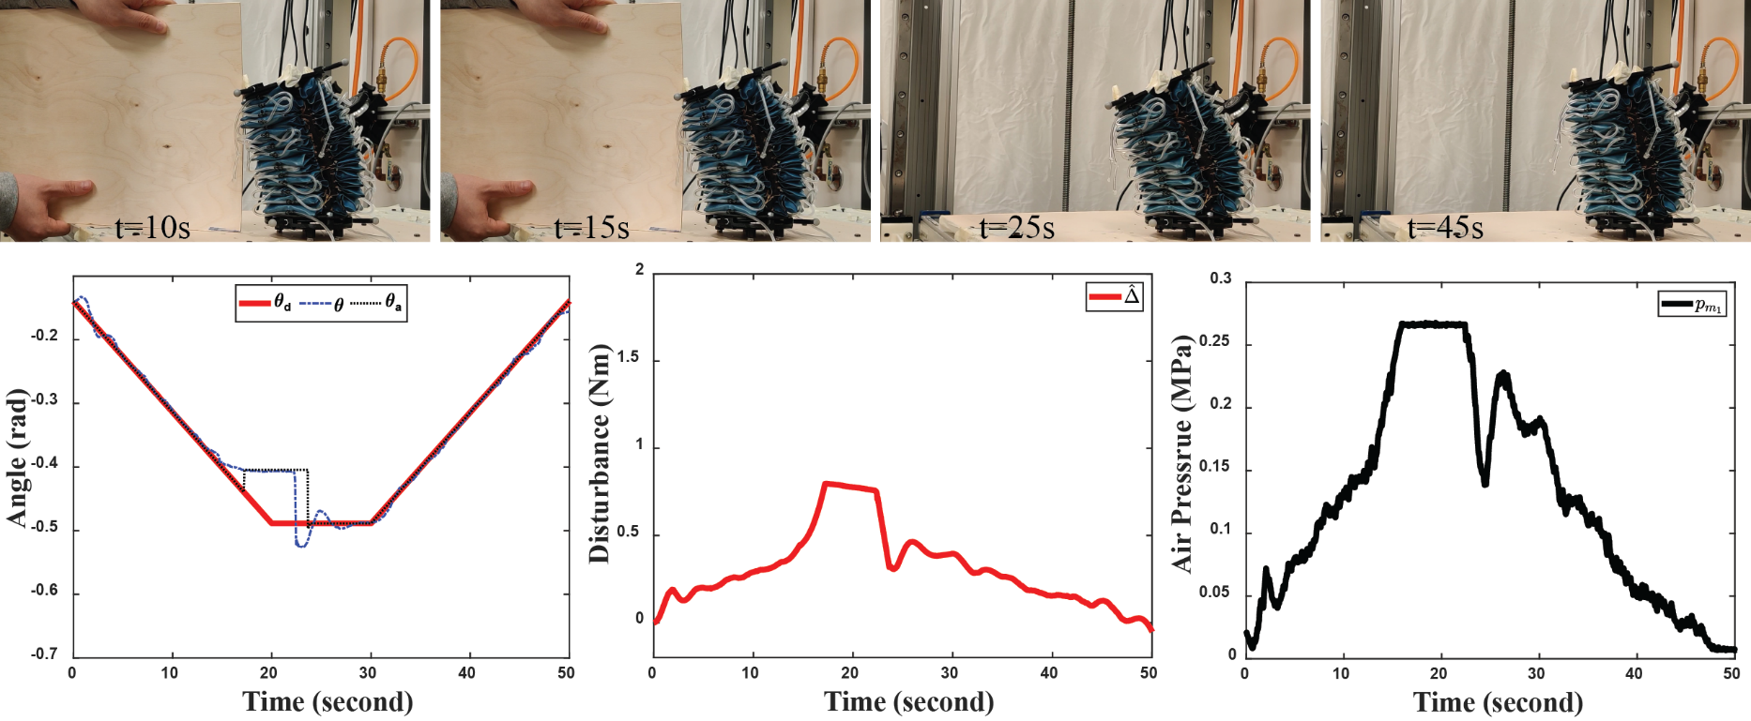
Experimental Results
Experiment setup
Ramp rate: 1 rad/s
Object stay till 22 secs
No further contact
Total of 5 trials
Key findings
SMCWNDOS can detect the contact
Controller can track the path
Low estimated disturbance values
Minimum oscillation after contact

Slide 13
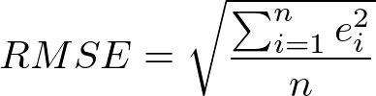
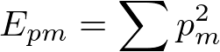
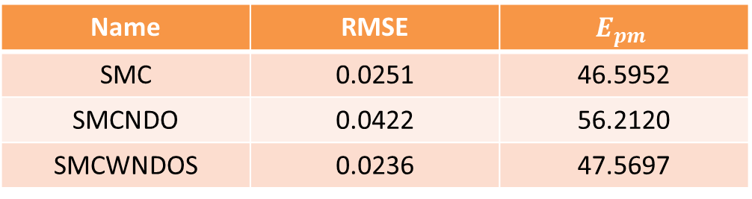
Evaluations of Experiments with Object
Averaged root-mean-square error (RMSE) of position errors
Results
SMC and SMCWNDOS shows similar performance when contact time is short.
SMCWNDOS shows least RMSE values
Averaged energy of the measured air pressures
Name | RMSE | $$E_{pm}$$
SMC | 0.0251 | 46.5952
SMCNDO | 0.0422 | 56.2120
SMCWNDOS | 0.0236 | 47.5697

